Slide 1


House Predection
Dani Rahardjo
21 March 2025

Slide 2

List of Contents
Background & Problem Statement
Objectives & Scope
Data Collection
Data Preprocessing
EDA & Distribution
Feature Selection
Correlation Matrix
Modelling

Slide 3

Background & Problem Statement
Background
The real estate market is dynamic and ever-changing, making house price prediction an essential tool for buyers, sellers, investors, and real estate professionals.
Problem Statement:
Accurate predictions help stakeholders make informed decisions, whether buying a dream home or planning a profitable investment. In recent years, machine learning has emerged as a game-changer in this field, offering unprecedented accuracy and insights compared to traditional statistical methods
Reference: https://www.appliedaicourse.com/blog/house-price-prediction-using-machine-learning/

Slide 4
Objectives & Scope
Objective:
Create and compare machine learning models that predict whether house prices. The goal is to identify house prices based on strategic factors.
Scope:
The project uses a dataset with house information, and the analysis is focused on applying classification techniques like Linear Regression, Random Forest and XGBoost.
The dataset can download here.

Slide 5
Data Collection
Data Source:
The dataset used, Train.csv, contains house details :

Slide 6
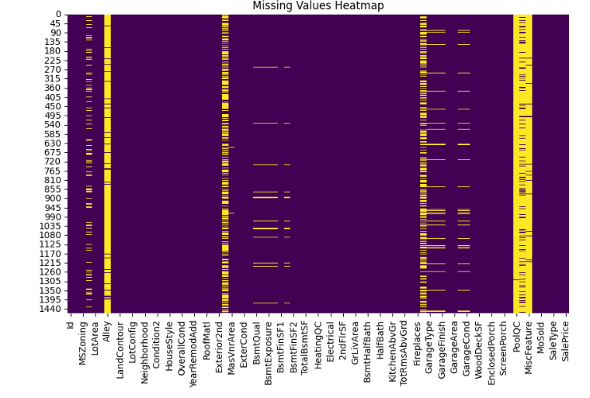
Data Preprocessing
Data Preprocessing:
There are 19 columns missing values were found.
Number of columns with null values: 19 Columns with null values: ['LotFrontage', 'Alley', 'MasVnrType', 'MasVnrArea', 'BsmtQual', 'BsmtCond', 'BsmtExposure', 'BsmtFinType1', 'BsmtFinType2', 'Electrical', 'FireplaceQu', 'GarageType', 'GarageYrBlt', 'GarageFinish', 'GarageQual', 'GarageCond', 'PoolQC', 'Fence', 'MiscFeature']

Slide 7
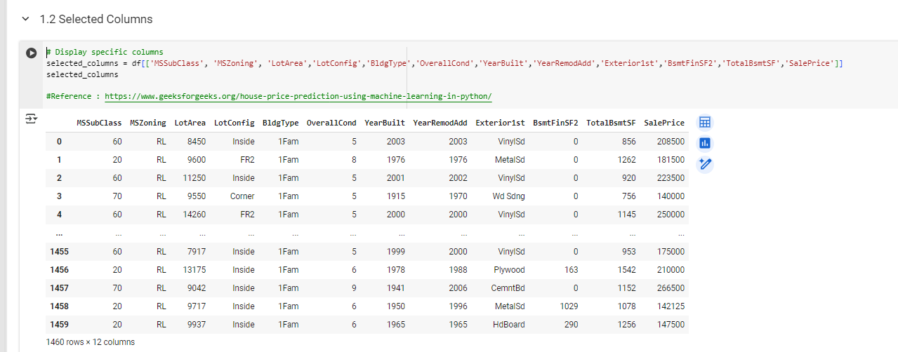
Data Preprocessing
Selected Columns:
Only 12 columns for selected based on reference from https://www.geeksforgeeks.org/house-price-prediction-using-machine-learning-in-python/

Slide 8
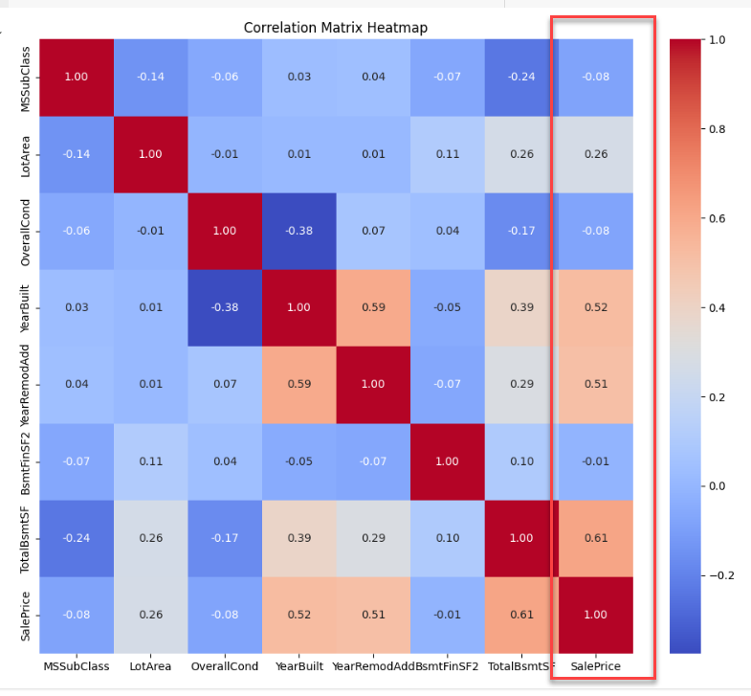
Exploratory Data Analysis (EDA) and Feature Engineering
Correlation Matrix

Slide 9
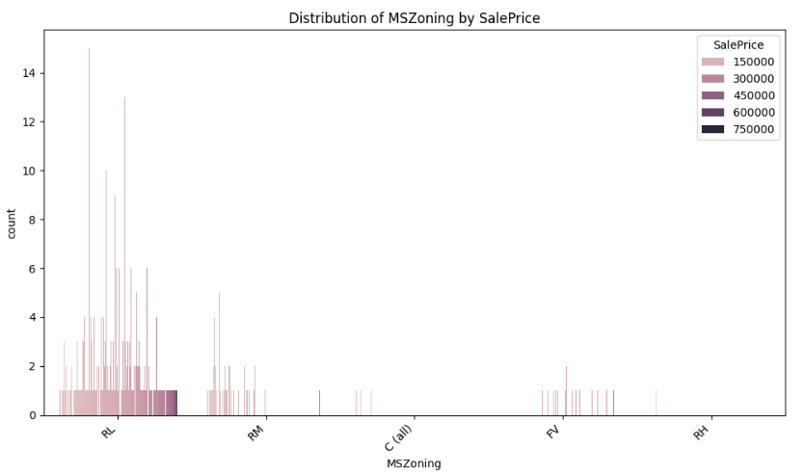
Feature Engineering
MSZoning - Identifies the general zoning classification of the sale.
A Agriculture
C Commercial
FV Floating Village Residential
I Industrial
RH Residential High Density
RL Residential Low Density
RP Residential Low Density Park
RM Residential Medium Density

Slide 10
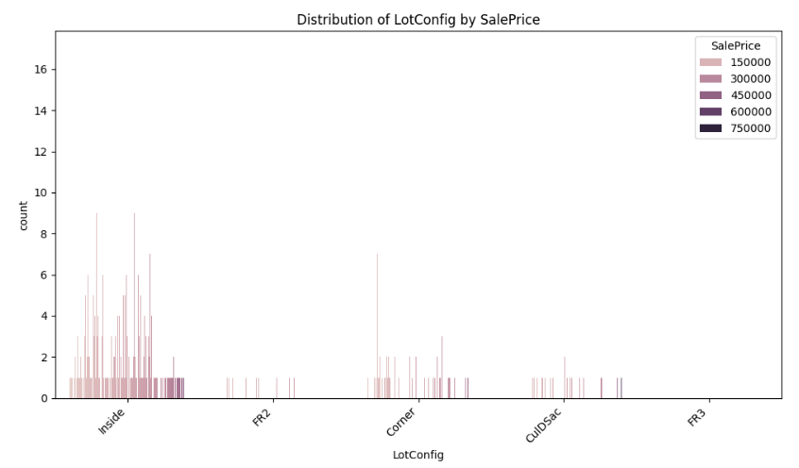
Feature Engineering
LotConfig : Lot Configuration
Inside Inside lot
Corner Corner lot
CulDSac Cul-de-sac
FR2 Frontage on 2 sides of property
FR3 Frontage on 3 sides of property

Slide 11
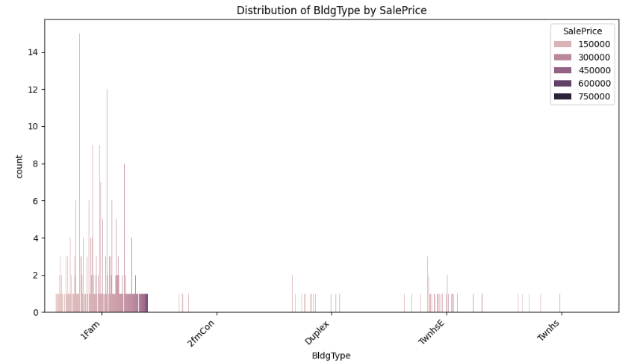
Feature Engineering
BldgType: Type of dwelling
1Fam Single-family Detached
2FmCon Two-family Conversion; originally built as one-family dwelling
Duplx Duplex
TwnhsE Townhouse End Unit
TwnhsI Townhouse Inside Unit

Slide 12
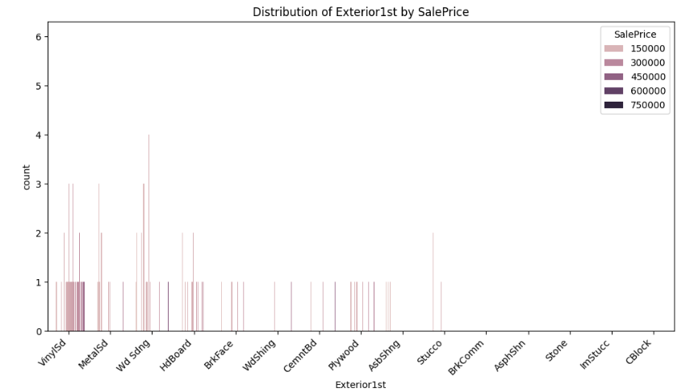
Feature Engineering
Exterior1st: Exterior covering on house
AsbShng Asbestos Shingles
AsphShn Asphalt Shingles
BrkComm Brick Common
BrkFace Brick Face
CBlock Cinder Block
CemntBd Cement Board
HdBoard Hard Board
ImStucc Imitation Stucco
MetalSd Metal Siding
Other Other
Plywood Plywood
PreCast PreCast
Stone Stone
Stucco Stucco
VinylSd Vinyl Siding
Wd Sdng Wood Siding
WdShing Wood Shingles

Slide 13
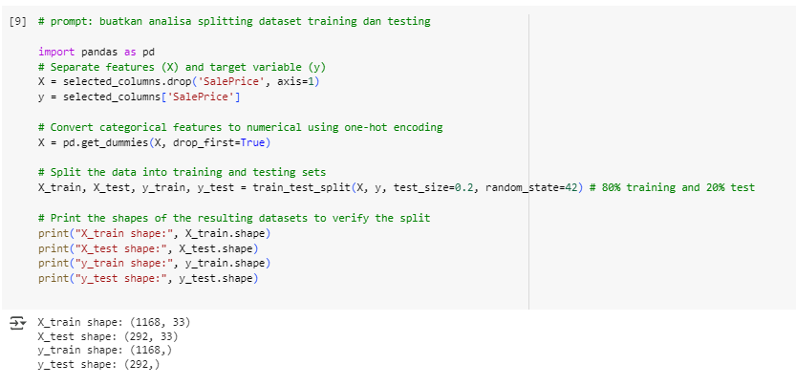
Splitting Dataset Training dan Testing

Slide 14
Model Development
Models Used:
Linear Regression: A linear model for binary classification tasks.
Random Forest: An ensemble learning method based on decision trees.
XGBoost: A gradient-boosting framework known for high performance in machine learning tasks.
Model Evaluation Metrics:
MSE
R-Squared
MAPE

Slide 15
Modelling
Linear Regression
Without Hyperparameter Tuning | Hyperparameter Tuning
Linear Regression - Mean Squared Error: 291845802958.55 Linear Regression - R-squared: 61.95% Linear Regression Train - Mean Squared Error: 230094964054.43 Linear Regression Train - R-squared: 61.42% | Best Linear Regression - Mean Squared Error: 291845802958.55 Best Linear Regression - R-squared: 61.95% Best Linear Regression Train - Mean Squared Error: 230094964054.43 Best Linear Regression Train - R-squared: 61.42%

Slide 16
Modelling
Random Forest
Without Hyperparameter Tuning | Hyperparameter Tuning
Random Forest - Mean Squared Error: 140759676342.44 Random Forest - R-squared: 81.65% Random Forest - Mean Squared Error Train: 19790071510.31 Random Forest - R-squared Train: 96.68% | Best Random Forest - Mean Squared Error: 126400648723.26 Best Random Forest - R-squared: 83.52% Best Random Forest - Mean Squared Error Train: 35963816335.41 Best Random Forest - R-squared Train: 93.97%

Slide 17
Modelling
XGBoost
Without Hyperparameter Tuning | Hyperparameter Tuning
XGBoost - Mean Squared Error: 159673241600.00 XGBoost - R-squared: 79.18% XGBoost - Mean Squared Error Train: 2173541600.00 XGBoost - R-squared Train: 99.64% | Best XGBoost - Mean Squared Error: 141491955200.00 Best XGBoost - R-squared: 81.55% Best XGBoost - Mean Squared Error Train: 17362028800.00 Best XGBoost - R-squared Train: 97.09%

Slide 18
Results Modelling
Model Comparison (Without Hyperparameter Tuning):
Model | MSE (Test) | R-Squared (Test) | MAPE (Test) | MSE (Train) | R-Squared (Train) | MAPE (Train)
Linear Regression | 291845802958.55 | 61.95% | 19.78% | 230094964054.43 | 61.42% | 18.08%
Random Forest | 140759676342.44 | 81.65% | 14.07% | 19790071510.31 | 96.68% | 4.91%
XGBoost | 159673241600.00 | 79.18% | 14.65% | 2173541600.00 | 99.63% | 1.99%
Model Comparison (With Hyperparameter Tuning):
Model | MSE (Test) | R-Squared (Test) | MAPE (Test) | MSE (Train) | R-Squared (Train) | MAPE (Train)
Linear Regression | 291845802958.55 | 61.95% | 19.78% | 230094964054.43 | 61.42% | 18.08%
Random Forest | 126400648723.26 | 83.52% | 13.90% | 35963816335.41 | 93.97% | 4.90%
XGBoost | 141491955200.00 | 81.55% | 13.50% | 17362028800.00 | 97.08% | 1.99%

Slide 19
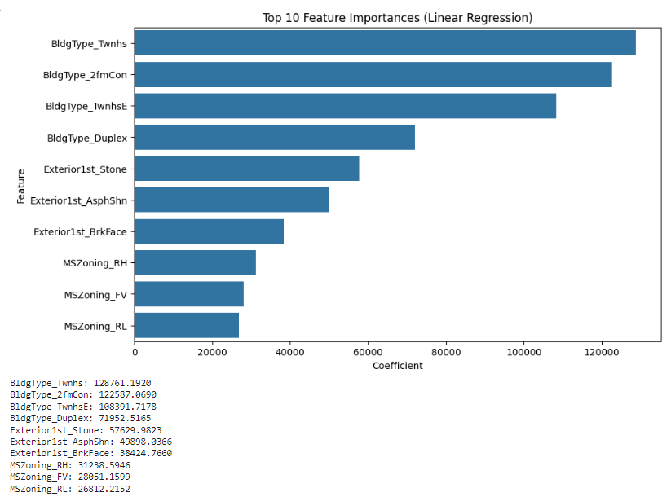
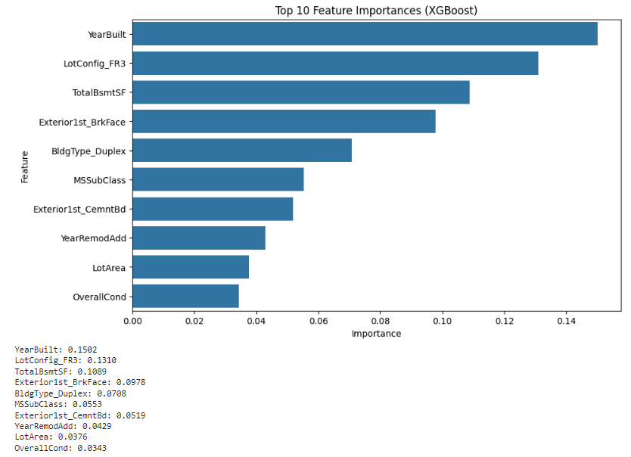
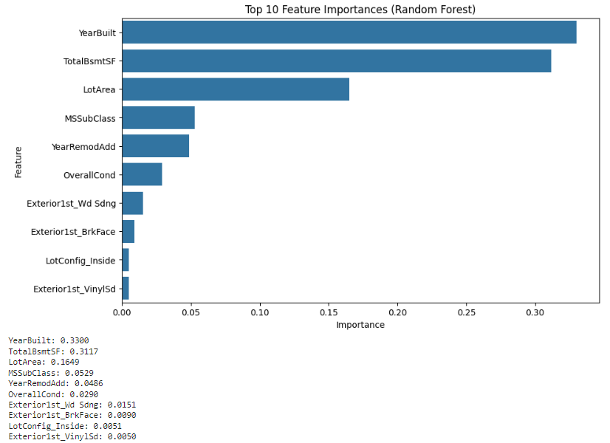
Feature Importance

Slide 20
Conclusion
Analyze and conclude which model is the best
Based on the results, we can see that ...
XGBoost (with hyperparameter tuning) generally has the best results on testing data.
Model overfitting occur in Random Forest (with and without hyperparameter tuning), where it has a better performance in train data but lower in test data.
Hyperparameter tuning improves the performance of all models for the test data.
Random Forest tends to have high training accuracy but lower test accuracy (potentially overfitting)
Linear Regression models have lower accuracy compared to Random Forest and XGBoost, but the model can be implemented simpler.
Based on the results, we can conclude that XGBoost (with hyperparameter tuning) is the best model for predicting Sales Price in this case, as it has the lowest Mean Squared Error (MSE) and highest R-squared on the testing data.
However, if there's high importance in a model that easy to implement, Linear Regression can be considered as alternative.

Slide 21


Contact Us
Don’t hesitate to contact us for further inquiries or any collaborations.
Your Full Name
Dani Rahardjo

